Slide 1


Slide 2
Since 2002, the Manitoba government has led a provincial elder abuse strategy focused on elder abuse prevention. The results in this presentation highlight work from April 1, 2021 – March 31, 2022.

Slide 3


Slide 4


Slide 5


Slide 6
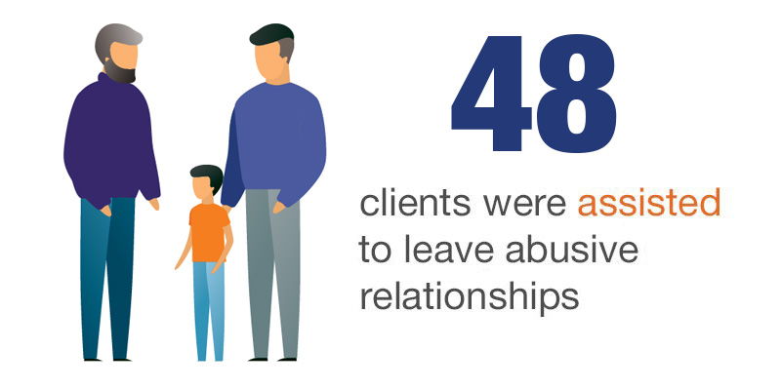

Slide 7


Slide 8


Slide 9


Slide 10


Slide 11


